Slide 1
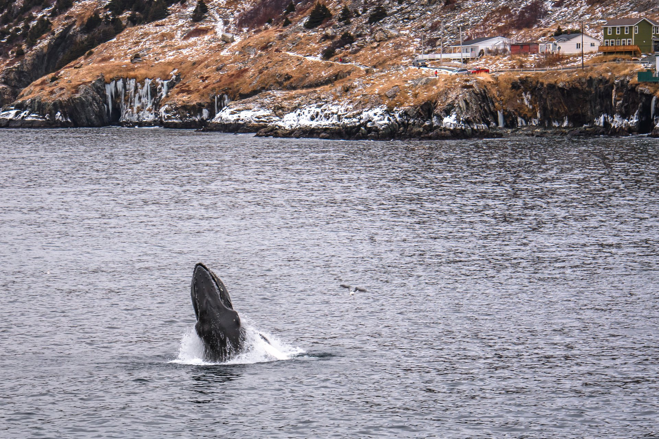
A Snapshot of NL Tourism
Presenter: Julia Penney, Manager of Tourism Product Development, Government of Newfoundland and Labrador

Slide 2
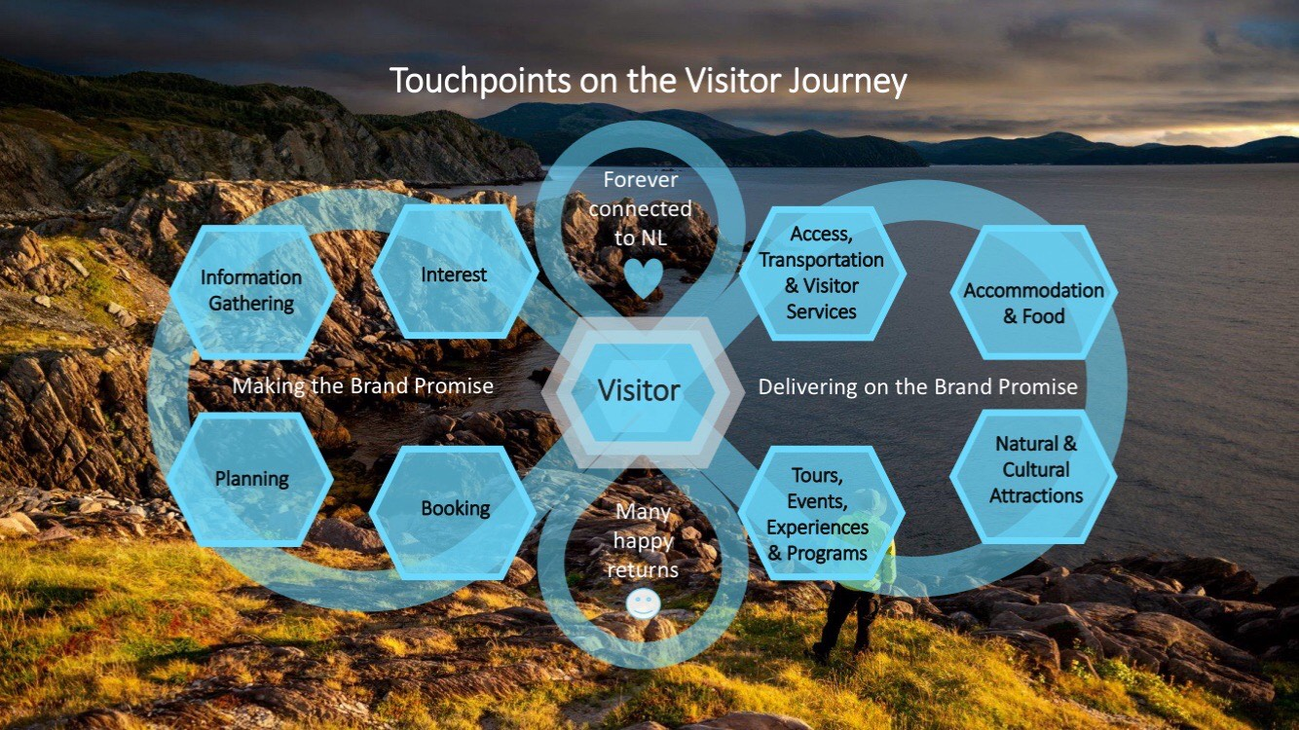
Notes:
We often talk about our visitor journey
Making the brand promise (Marketing)
Delivering (PD)
Visitors discover Newfoundland and Labrador through various channels, generating interest in its outdoor activities and cultural experiences.
After deciding to visit, they book their trip and experience seamless transportation and visitor services upon arrival.
During their stay, they engage with the province’s natural beauty and cultural heritage, from hiking and local cuisine to historic sites, all reflecting the brand promise.
They enjoy diverse accommodations and dining options that further deepen their connection to the destination.
The experience creates lasting memories, fostering emotional connections that increase the likelihood of return visits and positive word-of-mouth.

Slide 3
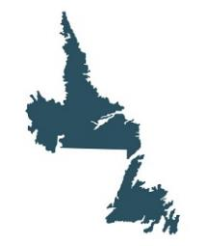





NL Tourism Industry Before COVID-19
TOURISM SPENDING & VISITATION
EMPLOYMENT IN TOURISM INDUSTRIES
In 2019, total tourism spending
was approx. $1.2 billion
There were over 2,700 tourism-related businesses in NL in 2019
There are over 20,000 jobs in tourism industries such as accommodations, food and beverage services, transportation, recreation and entertainment and travel services
Over 530,000 non-resident visitors travelled to NL in 2019
9% of all jobs in the province were related to tourism industries in 2019
Source: Department of Tourism, Culture, Arts and Recreation
Notes:
This slide sets the benchmark for 2019 tourism numbers to compare current and future trends.
Approximately $1.2 billion in total tourism spending in 2019
Over 2,700 tourism-related businesses in Newfoundland and Labrador in 2019
Over 530,000 non-resident visitors traveled to NL in 2019
9% of all jobs in the province were related to tourism industries in 2019
Equally Over 20,000 jobs in tourism sectors like accommodations, food and beverage, transportation, recreation, entertainment, and travel services in 2019

Slide 4
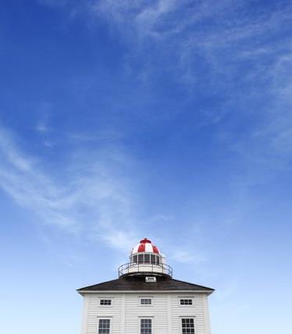
The tourism environment
COVID-19 had a devastating impact on the industry worldwide. Newfoundland and Labrador faces challenges including:
  Reduced air access
  Increased cost to travel and affordability of travelling here
  Increased competition
  Availability of and access to labour supply
  Increased cost of operations
  Limited financial capacity
  Seasonality
Notes:
Air access to Newfoundland and Labrador is steadily improving, with more flights and routes making it easier for visitors to reach us. While air access remains a priority due to our island location, the momentum is positive.
Travel affordability is also improving, but visitors to the province are typically experienced travelers with higher disposable incomes, seeking unique and authentic experiences.
Increased competition is pushing us to showcase what makes Newfoundland and Labrador unique, and we’re standing out with our distinctive offerings. Vision 2026 is supporting operators in building on our province's exceptional appeal.
The labor supply is improving, with more people entering the tourism workforce. Hospitality NL’s workforce action plan, supported by both provincial and federal governments, will help build back the tourism labour force.
While operational costs remain a challenge, operators are responding with innovative solutions, enhancing the resilience of the industry.
Seasonality is being addressed through initiatives promoting year-round tourism, spreading visitation and encouraging longer stays.
Overall, recovery is progressing well, and Vision 2026 is helping transform challenges into opportunities for sustainable growth.

Slide 5
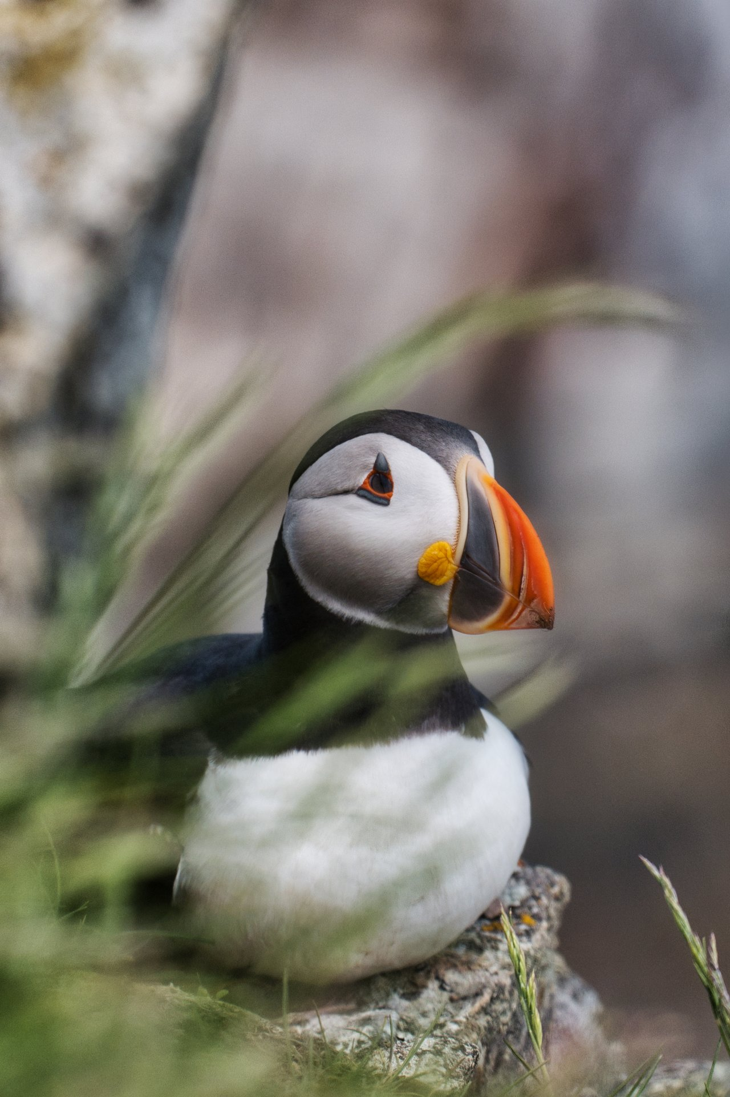
NL Tourism
Residents have played a key role in driving tourism growth, as Newfoundlanders and Labradorians increasingly explore their own backyards
Strong brand positioning has encouraged visitors to immerse themselves in the unique experiences this place offers
Travelers are drawn to expansive, open spaces, favoring nature and outdoor adventures
Visitors are opting for quality over quantity, embracing longer stays and choosing to visit during the off-season
Notes:
Residents played a key role in fueling tourism growth, as many Newfoundlanders and Labradorians rediscovered their own province during the pandemic. This local engagement helped to elevate the awareness of what we have to offer, creating new tourism advocates who shared their experiences.
A strong brand positioning has successfully encouraged visitors to explore Newfoundland and Labrador, offering them authentic and memorable experiences that showcase our unique culture, natural beauty, and friendly communities.
Travelers are increasingly seeking wide open spaces, with many prioritizing nature-based and outdoor experiences. Our province’s natural landscapes—such as rugged coastlines, national parks, and wilderness areas—are prime attractions for this demand.
There's a growing trend of visitors choosing quality over quantity. People are looking for more meaningful, immersive experiences, which is leading to longer stays and a shift towards visiting in the off-season. This trend is helping to spread out visitation throughout the year, contributing to more sustainable tourism.

Slide 6

Tourism RECOVERY
In 2023, Newfoundland and Labrador saw 487,000 non-resident visitors, up from 431,400 in 2022, but still down 8% compared to 2019 levels (530,000)
Cruise visitation in 2023 was 32% higher than 2019, with 61,000 visitors
Auto visitors totaled 113,600 in 2023, up 21% from 2019
Air visitors were 304,300 in 2023, which is down 21% compared to 2019 but represents a 10% improvement from 2023
Source: Tourism Highlights – 2023. Available at: https://www.gov.nl.ca/tcar/files/Monthly-Performance-Report_Full-Year-2023_FINAL_Updated12FEB2024.pdf
Notes:
Total non-resident visits were 487,000, a 13% increase from 2022. (530K in 2019)
In 2023, air visitation was 304,300, a 10% increase over 2022.
Overall, visitation (air, auto, cruise) is 8% below 2019 levels.
Auto visits totaled 113,600, up 3% from last year.
Cruise visitation grew by 55%, reaching 69,100 visitors.
Compared to 2019, auto visits were 21% higher and cruise visits were 32% higher, but air visitation remained 21% below pre-pandemic levels.
Marine Atlantic passenger movements increased by 4%, totaling 368,039, and were up 19% from 2019.
Vehicle movements increased by 3%, reaching 145,349, up 21% from 2019.
Auto visitation saw a 3% increase in 2023 compared to last year.

Slide 7

Vision 2026
Transition 2022-2023 – A short-term strategy that transitions tourism to more solid footing, building capacity to grow visitation to pre-2020 levels
Transformation 2024-2026 – A comprehensive medium-to-long-term strategy that transforms tourism on a sustainable path of consistent and responsible annual visitation, spending and employment growth
Thrive 2026 and Beyond – A long-term strategy focused on guiding and supporting tourism development with an equal focus on both economics and
the well-being of people and places, also referred to as
regenerative tourism. In this phase of Vision 2026,
tourism is thriving by constantly monitoring and adapting
to the dynamic and ever-changing tourism environment
https://www.gov.nl.ca/tcar/tourism-division/vision-2026/
Notes:
The pandemic provided tourism leaders across the province with a unique opportunity to reflect on both the challenges and opportunities the industry faces. It allowed us to pause, assess where we are, and think about how we can rebuild on a solid foundation.
Looking ahead, Destination Canada predicts a growing interest in the well-being of communities and residents in the destinations travelers choose. More than ever, people are seeking authentic experiences and becoming increasingly conscious of their environmental impact.
By focusing on sustainability, we can responsibly rebuild tourism and ensure high-quality visitation while protecting the very things that make our destination special.
While the pandemic presented many challenges, it has also given us the chance to make important improvements and create a stronger, more resilient foundation for the future of our tourism industry

Slide 8
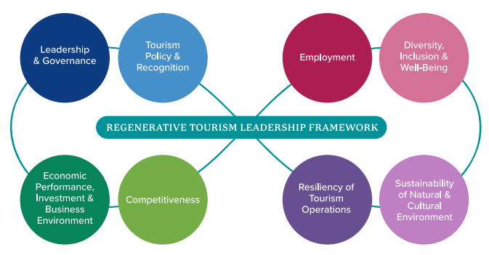
Vision 2026
Notes:
• Vision 2026 introduces regenerative tourism as a way to shape the future of tourism in Newfoundland and Labrador. It’s about more than just sustainability; it focuses on rejuvenating the environment and communities that tourism depends on.
• The approach is aligned with the United Nations’ Sustainable Development Goals, making it part of a global effort to promote sustainable and balanced growth in all areas—social, economic, and environmental.
• Regenerative tourism aims to build a tourism ecosystem that is resilient and adaptable, helping to restore and protect both natural and community resources, while supporting long-term economic growth.
• Collaboration is key. This strategy brings together private, public, and community stakeholders, ensuring that tourism development is well-coordinated and sustainable over time.
• The goal is to preserve and enhance Newfoundland and Labrador’s cultural and natural assets. This is about creating a vibrant, thriving destination that benefits both visitors and residents for generations to come.
• Decision-making in regenerative tourism is based on constant monitoring and feedback. By staying engaged with how things are evolving, stakeholders can adapt and keep the industry competitive.
• Growth in tourism needs to align with the capacity of the industry and the community. This helps to ensure quality experiences for visitors while minimizing negative impacts on locals and the environment.
• Regenerative tourism is about co-designing experiences with the local communities. It’s about building deeper connections with visitors and making sure tourism respects the province’s rich culture and natural beauty.
• This approach focuses on ensuring tourism delivers lasting, positive benefits to people, places, and nature. It moves away from traditional models that sometimes take more than they give, instead focusing on reciprocal relationships between tourism and local life.
• The tourism ecosystem is seen as a "living" system, always evolving and adapting. This approach allows the industry to respond to challenges and opportunities in real-time, ensuring it remains sustainable and resilient.
• Regenerative tourism offers unforgettable, authentic experiences that not only contribute to the economy but also enrich the sociocultural and environmental fabric of Newfoundland and Labrador.
• Ultimately, the vision is to renew and restore Newfoundland and Labrador as a responsible tourism destination. This will take time, but with collaboration from all stakeholders, it’s a vision that will contribute to the well-being of the province for years to come.

Slide 9
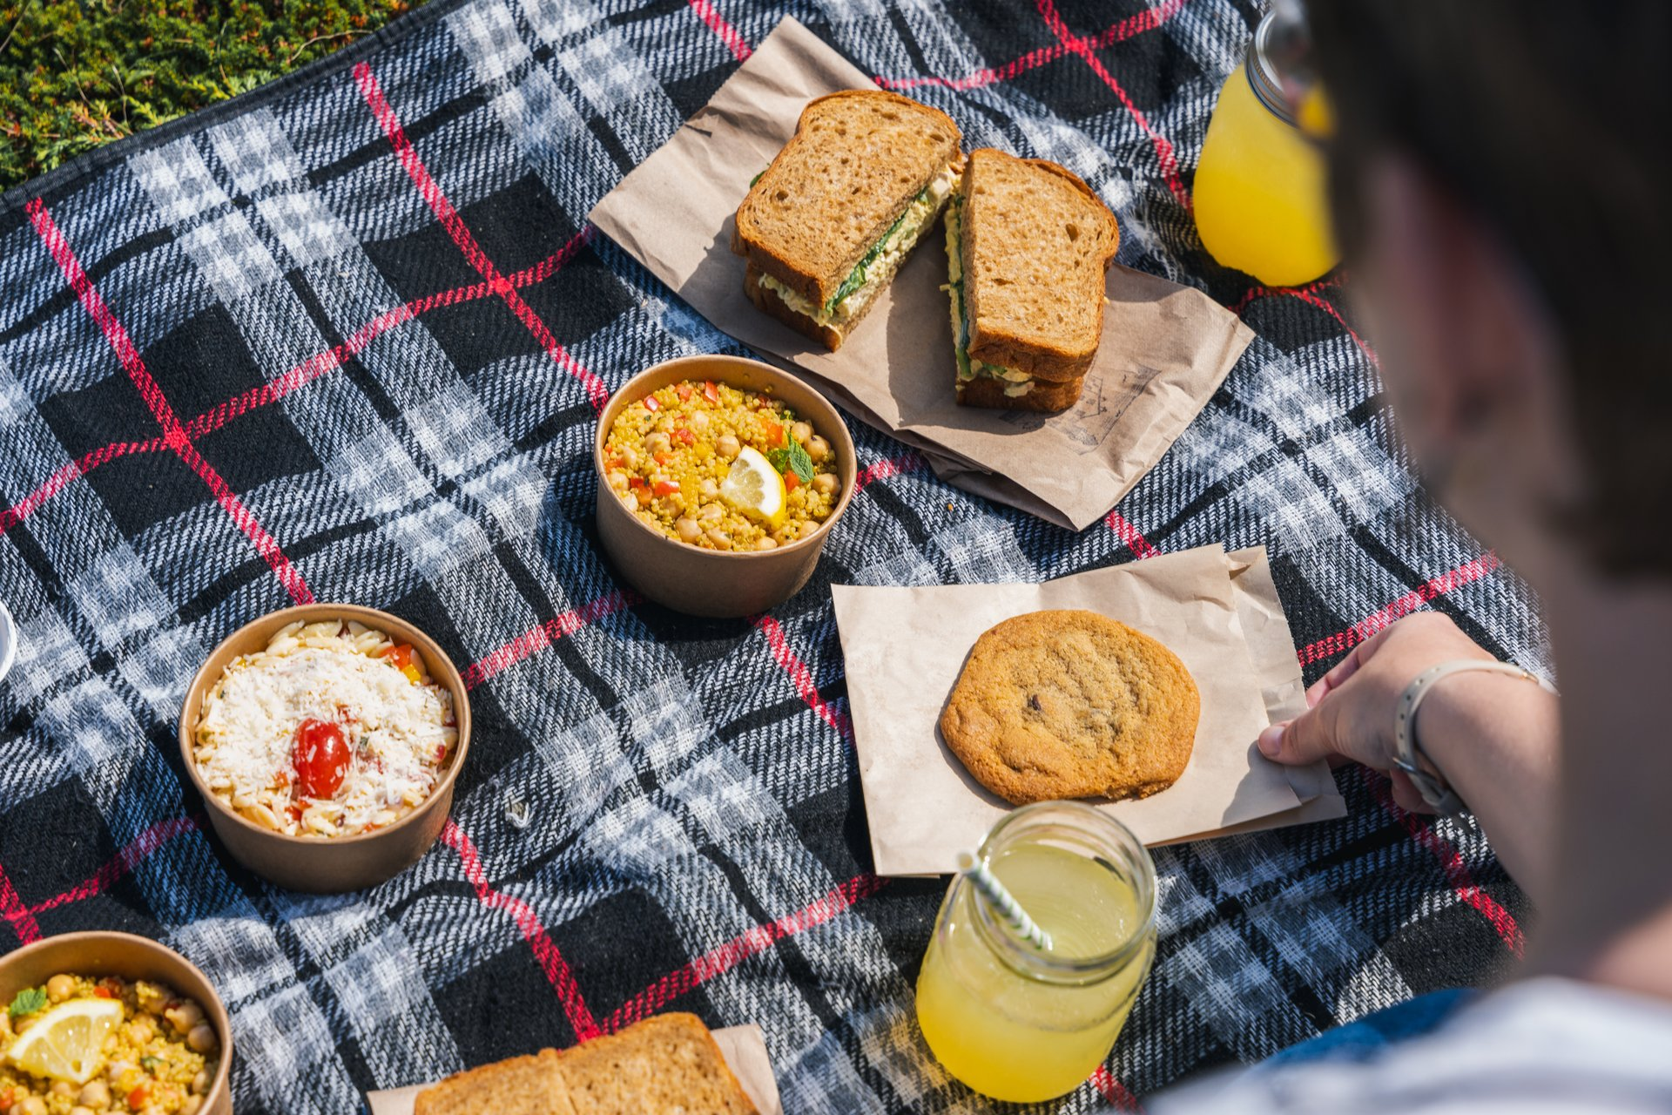
Vision 2026 Product Development Priorities
Arts and Culture: Showcases Newfoundland and Labrador’s vibrant arts, music, and heritage through immersive cultural experiences
Culinary: Promotes local cuisine, celebrating unique flavors and ingredients like seafood and berries
Indigenous: Highlights Indigenous culture through storytelling, events, and respectful, authentic experiences
Nature: Focuses on sustainable outdoor tourism, leveraging the province’s dramatic landscapes and wildlife
Source: Newfoundland and Labrador Resident Travel Survey. Available at: https://www.gov.nl.ca/tcar/files/Peak-Season-Non-resident-Visitor-Survey_Final.pdf
Notes:
Arts and culture are integral to Newfoundland and Labrador, creating unforgettable visitor experiences grounded in music, storytelling, and heritage.
We’re prioritizing local artists and events that showcase unique cultural expressions—from our traditional music to festivals rooted in history.
Culinary experiences here offer a taste of Newfoundland and Labrador’s distinctive flavors—fresh seafood, wild berries, and age-old recipes.
By supporting local food experiences, we’re helping guests connect with our culture through memorable meals.
Indigenous culture is a cornerstone of our tourism strategy, focusing on authentic experiences that celebrate traditions, stories, and ways of life.
Our partnerships with Indigenous communities help visitors engage meaningfully with the province’s heritage.
Nature tourism is essential, allowing visitors to immerse themselves in our breathtaking landscapes responsibly.
Sustainable tourism development ensures guests enjoy our coastlines, fjords, and wildlife while protecting these assets for the future.

Slide 10
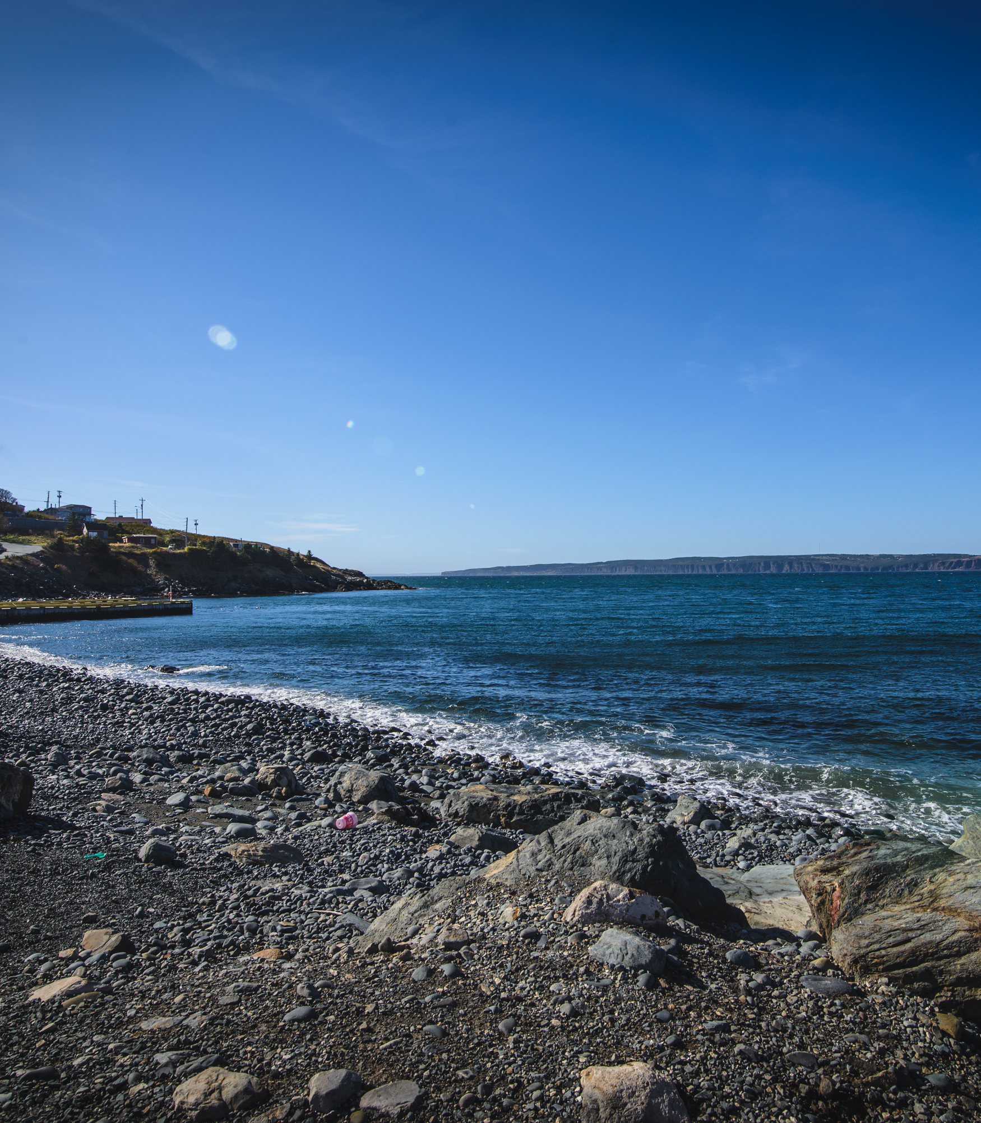
What are visitors looking for?
It takes deliberate action to visit here.
No matter where they’re from, visitors today seek more from their vacation experience.
They want to be part of something memorable and unique to this place.
Notes:
It takes deliberate action to visit Newfoundland and Labrador.
Visitors today are seeking more from their vacation experience.
They want to be part of something memorable and unique to this place.
Visitors are looking for authentic experiences connected to our culture, people, and natural environment.
The goal is for their time here to leave a lasting impression—an experience they’ll share long after they leave.
Visitors today seek authentic, unique experiences that align with Vision 2026’s focus on showcasing Newfoundland and Labrador’s distinct culture, heritage, and natural environment.
The province’s tourism goals are focused on delivering high-quality, sustainable experiences that resonate with experienced, knowledgeable travelers looking for self-expression and discovery.
Vision 2026 supports the development of diverse tourism offerings that meet visitors’ expectations of value while enhancing their overall satisfaction.
By aligning our tourism offerings with these evolving trends, we can foster sustainable growth, attract more visitors, and create lasting positive impressions.

Slide 11
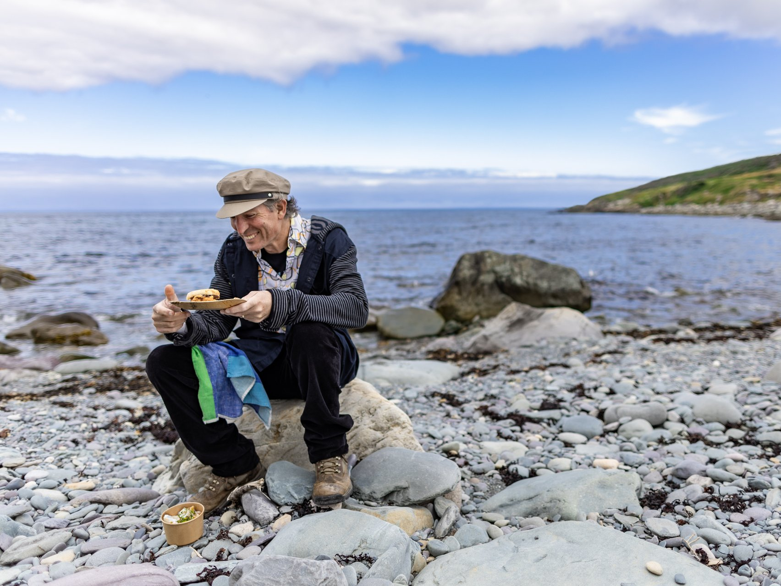
Touring & explorer market
Visitors are:
Looking to discover the unusual, the exotic, the unscripted, and off-the-beaten-path
Knowledgeable, experienced, and curious visitors for whom travel is a form of self-expression and discovery
Seeking a broad range of authentic, quality tourism experiences
Expecting to receive value for their money
Notes:
Visitors today seek authentic, unique experiences that align with Vision 2026’s focus on showcasing Newfoundland and Labrador’s distinct culture, heritage, and natural environment.
The province’s tourism goals are focused on delivering high-quality, sustainable experiences that resonate with experienced, knowledgeable travelers looking for self-expression and discovery.
Vision 2026 supports the development of diverse tourism offerings that meet visitors’ expectations of value while enhancing their overall satisfaction.
By aligning our tourism offerings with these evolving trends, we can foster sustainable growth, attract more visitors, and create lasting positive impressions.

Slide 12
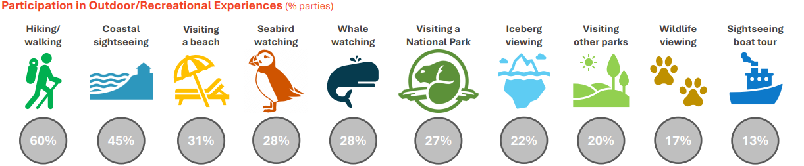
Outdoor Activities and Experiences
Source: Newfoundland and Labrador Non-Resident Travel Survey. Available at: https://www.gov.nl.ca/tcar/files/Peak-Season-Non-resident-Visitor-Survey_Final.pdf
Notes:
Our visitors are active explorers who aim to experience as much as possible during their stay. Many report not staying long enough to do everything they wanted, which often means they plan to return for more.
Hiking and trail walking are top outdoor activities, with 60% of visitors hitting the trails and 4% choosing guided hikes.
Coastal sightseeing is also popular, drawing in 45% of visitors eager to experience the province’s dramatic coastlines.
Wildlife encounters are a highlight for many, with 28% of visitors participating in both seabird and whale watching. Among these, 15% opted for whale-watching boat tours, while 14% took boat tours to observe seabirds up close.
Other outdoor favorites include beach visits (31%), exploring national parks (27%), iceberg viewing (22%), and visits to additional parks and ecological reserves (20%).
Overall, 93% of visitors took part in at least one outdoor experience during their trip, with vacation visitors engaging in a wider variety of outdoor activities than other visitor types.

Slide 13
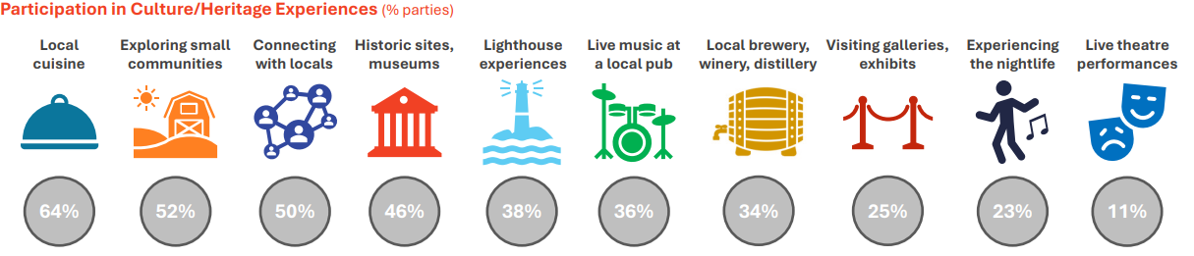
Culture and Heritage Experiences
Source: Newfoundland and Labrador Non-Resident Travel Survey. Available at: https://www.gov.nl.ca/tcar/files/Peak-Season-Non-resident-Visitor-Survey_Final.pdf
Notes:
Our culture, history, and heritage are major reasons visitors are motivated to travel to Newfoundland and Labrador; these elements truly set us apart from other destinations, as our surveys have consistently shown.
Newfoundland and Labrador offers a wealth of history for visitors to discover, with numerous historic, cultural, and heritage sites where they can immerse themselves in the province’s past.
Experiencing local culture and meeting the people who live here are often trip highlights for visitors, with 50% of visitors reporting that connecting with locals was a memorable part of their stay.
Trying local cuisine is especially popular, with 64% of visitors making it a priority to experience Newfoundland and Labrador’s unique flavors, while 52% enjoyed exploring our rural and small communities, gaining a sense of place and lifestyle.
Nearly half (46%) of visitors visited historic sites, museums, or interpretation centers, further connecting with the rich heritage Newfoundland and Labrador has to offer.
Iconic sites like lighthouses drew in 38% of visitors, who found these locations to be both visually stunning and culturally significant.
Vacation visitors were especially engaged in cultural activities, participating in experiences like visiting lighthouses, historic sites, rural communities, galleries, and local breweries or distilleries at higher rates than other types of travelers.

Slide 14
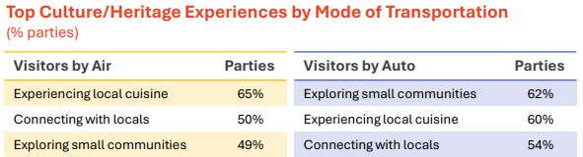
Culinary Experiences are of Growing Interest to Travellers
Culinary experiences are a key focus of
Vision 2026
Many residents associate memorable trips
with local food, drink, and friendly
interactions with locals
Packages featuring local food and drink along with nearby attractions (trails, beaches, parks, historic sites) may encourage more in-province vacations
3 in 10 residents would plan a trip around food/drink festivals or live performances
Vision 2026’s Transformation phase focuses on partnership opportunities to improve access to local food and beverage products
Hospitality NL received over $1 million for the Newfoundland and Labrador Culinary Tourism Development Strategy to establish the province as a premier culinary destination, boosting visitation and sustainable economic growth
Source: 2023 Visitor Exit Survey – Highlights. Available at: https://www.gov.nl.ca/tcar/files/2023-Exit-Survey-Highlights-Report_FINAL.pdf
Source: Newfoundland and Labrador Resident Travel Survey. Available at: https://www.gov.nl.ca/tcar/files/Resident-Travel-Survey_Peak-Season-2023_FINAL.pdf
Notes:
Culinary experiences are a major priority within Vision 2026, as they play a significant role in shaping visitors' memorable experiences in Newfoundland and Labrador.
Many visitors reflect on their trips through the lens of local food, drink, and interactions with friendly locals, emphasizing the importance of food tourism in creating lasting impressions.
To encourage more in-province travel, offering packages that combine local food and drink with nearby attractions—such as hiking trails, beaches, parks, and historic sites—can be an effective strategy.
Approximately 30% of residents would be inclined to plan an entire trip around food and drink festivals or live performances, indicating a strong interest in culinary and cultural experiences.
As part of Vision 2026’s Transformation phase, there is a focus on identifying partnership opportunities that will enhance access to local food and beverage products, benefiting both businesses and consumers.
Recently, Hospitality NL received over $1 million for the Newfoundland and Labrador Culinary Tourism Development Strategy. This two-year project aims to position the province as a premier culinary destination, attracting more visitors and driving sustainable economic growth.

Slide 15
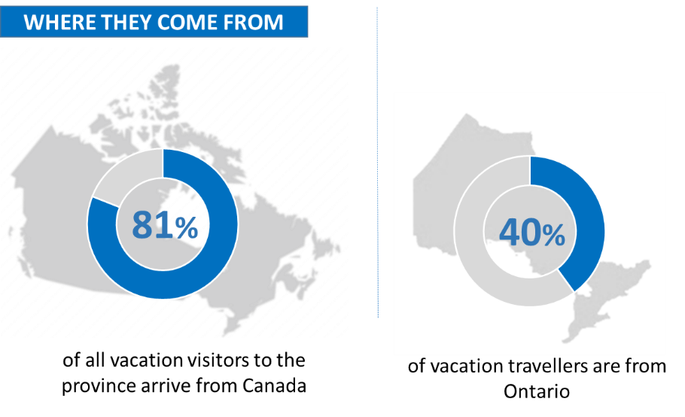
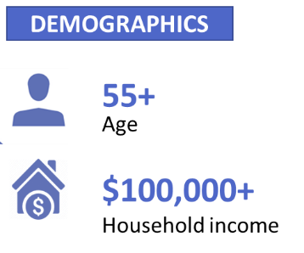
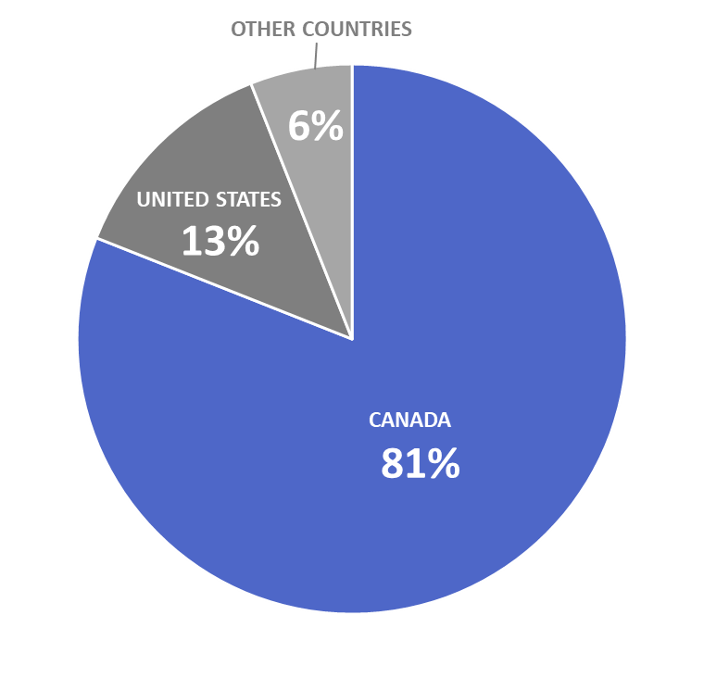
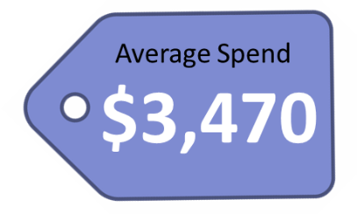
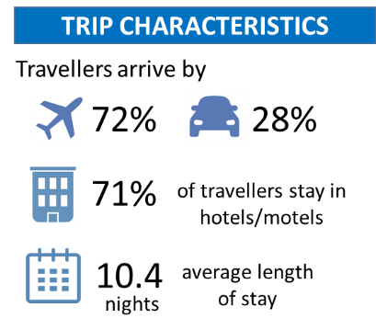
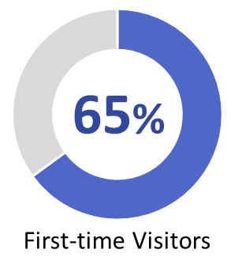

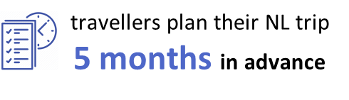
Most vacationers come from other Canadian provinces
Notes:
81% of non-resident vacation/leisure visitors arrive from other Canadian provinces; 13% come from the US and 6% from overseas
40% of all vacation visitors are from Ontario – Ontario remains NL’s largest source market
72% of visitors arrive by plane, while 28% drive to the province
Half travel as couples with no children and 65% are visiting the province for the first time
They are typically over 55 years of age and have above average household incomes
Most stay in hotels
They stay for an average of just over 10 nights
Vacation visitors begin planning their NL trip an average of 5 months in advance
Their average trip spend is $3,470

Slide 16








Provincial Tourism Product Development
We create and deliver Newfoundland and Labrador brand experiences that:
  Attract more visitors
  Encourage them to stay longer
  Experience more
Notes:
Our tourism success relies heavily on strong partnerships with key organizations across the province.
Hospitality Newfoundland and Labrador (HNL) is a primary industry association, representing the interests of tourism operators and supporting workforce development.
The Newfoundland and Labrador Indigenous Tourism Association (NLITA) plays a vital role in promoting Indigenous tourism, preserving cultural heritage, and offering authentic experiences.
Regional marketing associations, like Destination Labrador, Destination St. John’s, Adventure Central, Go Western Newfoundland, and Legendary Coasts, focus on marketing specific regions, each with its own attractions and unique experiences.
The Atlantic Canada Opportunities Agency (ACOA) is a critical federal partner, helping fund projects that drive tourism growth and improve infrastructure.
Our collective goal is to create and deliver memorable Newfoundland and Labrador brand experiences.
These experiences are designed to attract more visitors, encouraging them to stay longer and engage more deeply with what our province has to offer.

Slide 17
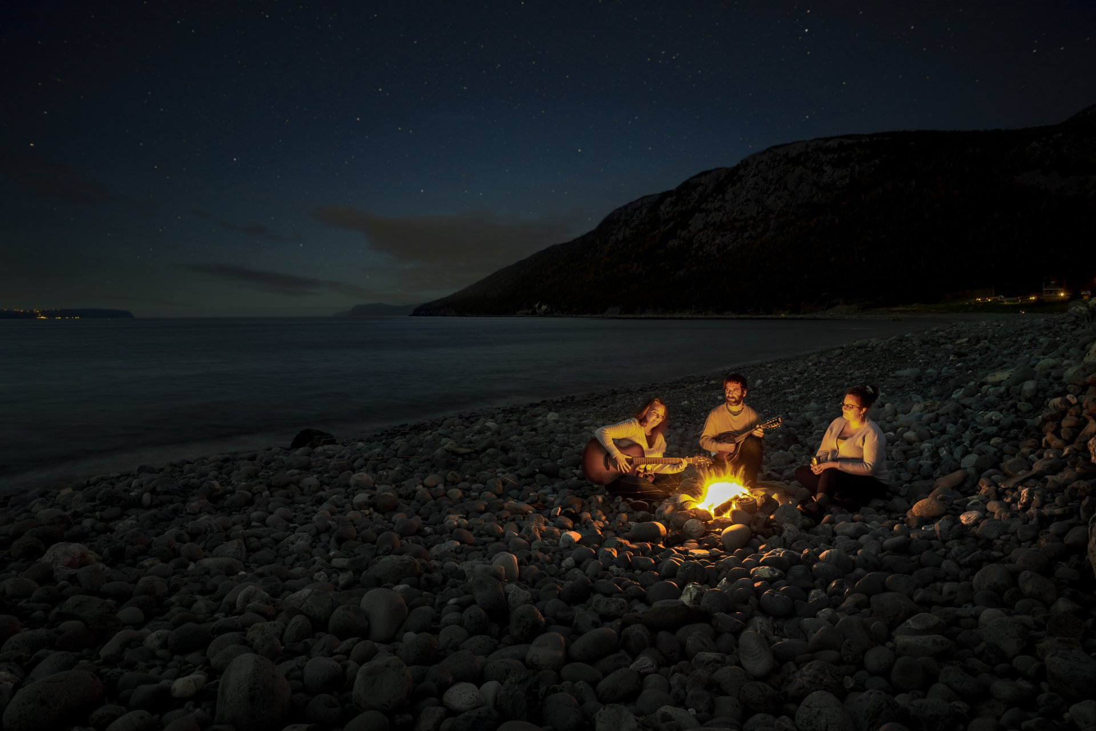
Thank you
Julia Penney, Manager of Tourism Product Development
✉ juliapenney@gov.nl.ca
✆ 709-729-6588
Notes:
Thank you
How can we help?

